Slide 1


CHAT WITH DOCUMENTS USING HUGGING FACE OPEN-SOURCE LLMs

Slide 2






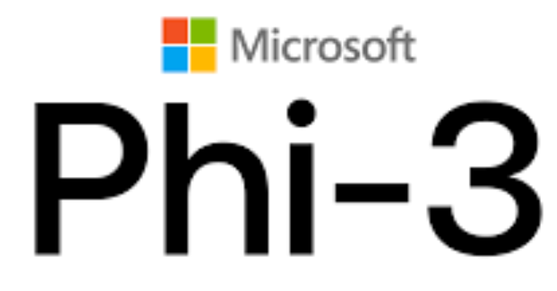
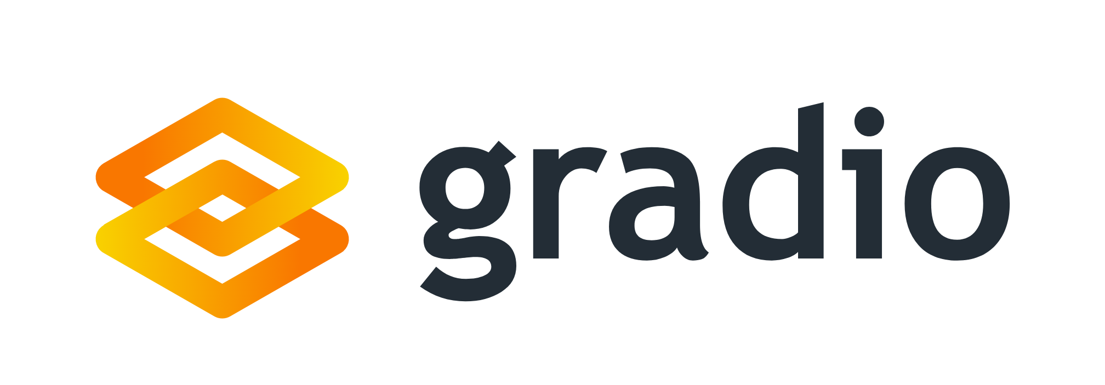
Project Overview
In our previous projects, we've explored closed-source paid models. Now, let’s explore the world of open-source models available on Hugging Face.
We will build a question answering system where users can upload PDFs and chat with their content.
Document
Model Output
Earnings Transcript
© All rights reserved for Dr. Ryan Ahmed @Stemplicity Inc.
Get answers generated by different open-source LLMs (e.g.: LLama, Gemma, Phi, or Qwen) running locally.
Question
Summarize this document & generate risk factors

Slide 3

Key Learning Outcomes
Learn what Hugging Face is by exploring the Hub and understanding its role in the AI ecosystem.
Use the Transformers library to work with Hugging Face models in Python.
Load open-source models by downloading pre-trained model weights and tokenizers from Hugging Face.
Run models efficiently using quantization techniques like bitsandbytes to fit them within Colab’s free GPU memory.
Read PDF content by extracting text using Python libraries such as pypdf.
Apply basic prompt engineering techniques to structure questions for models based on input text.
Build a user interface with Gradio to interact with your document Q&A system and switch between models.
Learn the difference between pipeline(), AutoTokenizer, & AutoModelForCausalLM
© All rights reserved for Dr. Ryan Ahmed @Stemplicity Inc.

Slide 4
WHAT IS HUGGING FACE?

Slide 5
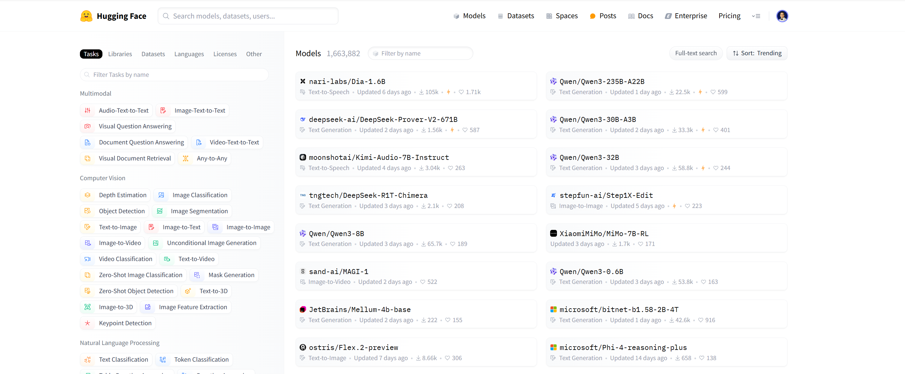
What is Hugging Face?
Hugging Face has become a central hub for the Machine Learning community, especially for LLMs & Natural Language Processing (NLP).
On Hugging Face Hub, you can find:
Models: Thousands of pre-trained models for various tasks (text generation, translation, image classification, etc.).
Datasets: A vast collection of datasets used to train and evaluate models.
Spaces: Demos of AI models hosted on HF infrastructure (like Gradio apps!)
© All rights reserved for Dr. Ryan Ahmed @Stemplicity Inc.

Slide 6
Why Use Open-Source Models from Hugging Face?
Control: You run the model yourself, giving you more control over data privacy and customization.
Cost: Running smaller models can be cheaper than constantly hitting paid APIs, especially during development.
Transparency: You can often study the model architecture and sometimes even the training data.
Community: Access to a huge variety of models fine-tuned for specific tasks.
Offline Use: Once downloaded, models can potentially be run without an internet connection.
© All rights reserved for Dr. Ryan Ahmed @Stemplicity Inc.

Slide 7
What is GPT?
GPT stands for Generative Pre-trained Transformer. It is an AI model designed to generate human-like text based on the input it receives.
Generative:
Refers to the model's ability to generate new, coherent text. It predicts the next word based on the context of the input text.
Pre-trained:
The model is trained on a large dataset from various sources (books, articles) before it is fine-tuned for specific tasks. Pre-training enables it to understand grammar and facts.
Transformer:
A transformer is a type of neural network that processes sequential data. It uses self-attention to weigh the importance of words, enabling it to understand context.
© All rights reserved for Dr. Ryan Ahmed @Stemplicity Inc.

Slide 8
What is Self Attention?
Self-attention is a way for a model to figure out which words in a sentence are most important when trying to understand the meaning or make predictions.
Example: Imagine you're reading the sentence: "The cat, which was hungry, chased the mouse."
If you're trying to figure out what "chased" is about, your brain automatically focuses on "cat" and "mouse," not "was hungry." This "focusing" is like self-attention.
The model does something similar—it assigns a weight to each word to decide how much attention it should pay to that word when understanding the sentence.
In simple terms, self-attention helps the model know which words to "pay attention to" at different points, depending on what it's trying to learn or generate.
© All rights reserved for Dr. Ryan Ahmed @Stemplicity Inc.

Slide 9
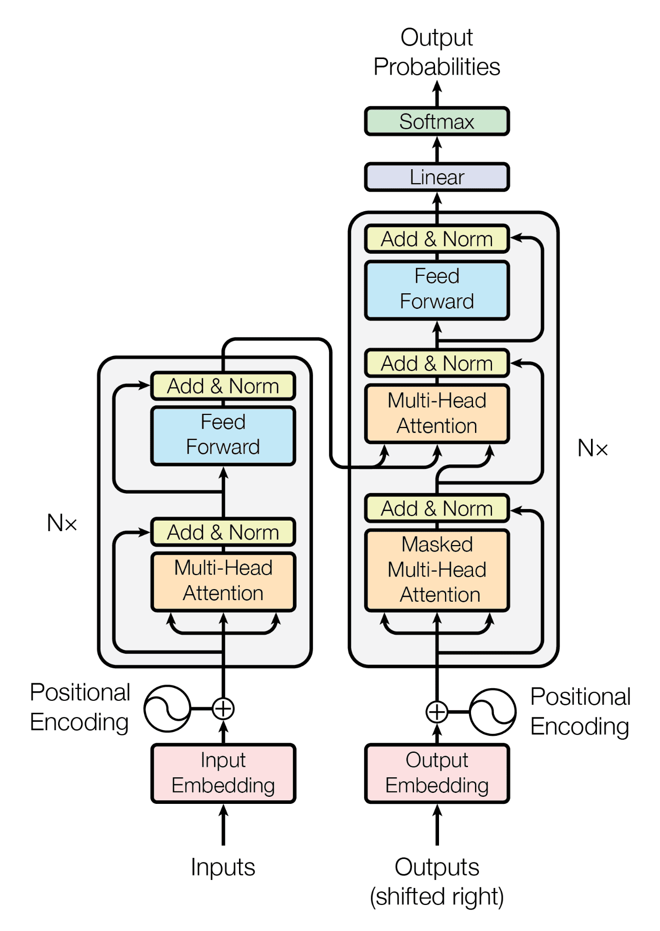
What is a Transformer?
The transformer architecture is an AI model for processing text, designed to understand and generate language efficiently.
Input Tokens (Words or Pieces of Words): It starts by breaking text into smaller chunks (tokens), like words or parts of words. For example, "I love cats" becomes [I, love, cats].
Self-Attention (Focus Mechanism): Imagine reading a sentence like: "The cat sat on the mat because it was soft." To figure out what "it" refers to, you need to think about "mat." The transformer uses self-attention to decide which words in the sentence are important to focus on. This helps it understand the context better.
© All rights reserved for Dr. Ryan Ahmed @Stemplicity Inc.
Attention Is All You Need: https://arxiv.org/abs/1706.03762

Slide 10
What is a Transformer?
Layers (Like Thinking Steps): The model processes the input in multiple layers, where each layer refines its understanding. For example:
Layer 1 might focus on word meanings.
Layer 2 might figure out relationships between words.
Layer 3 might understand the whole sentence.
Positional Information (Word Order): Since the model reads all the words at once, it also adds positional encoding to know the order of the words (e.g., knowing "the cat" is different from "cat the").
Output (Final Prediction): After processing, it predicts the next word, translates text, summarizes, or performs another task. For example, if you type "I love," it might predict "cats."
© All rights reserved for Dr. Ryan Ahmed @Stemplicity Inc.
Attention Is All You Need: https://arxiv.org/abs/1706.03762

Slide 11
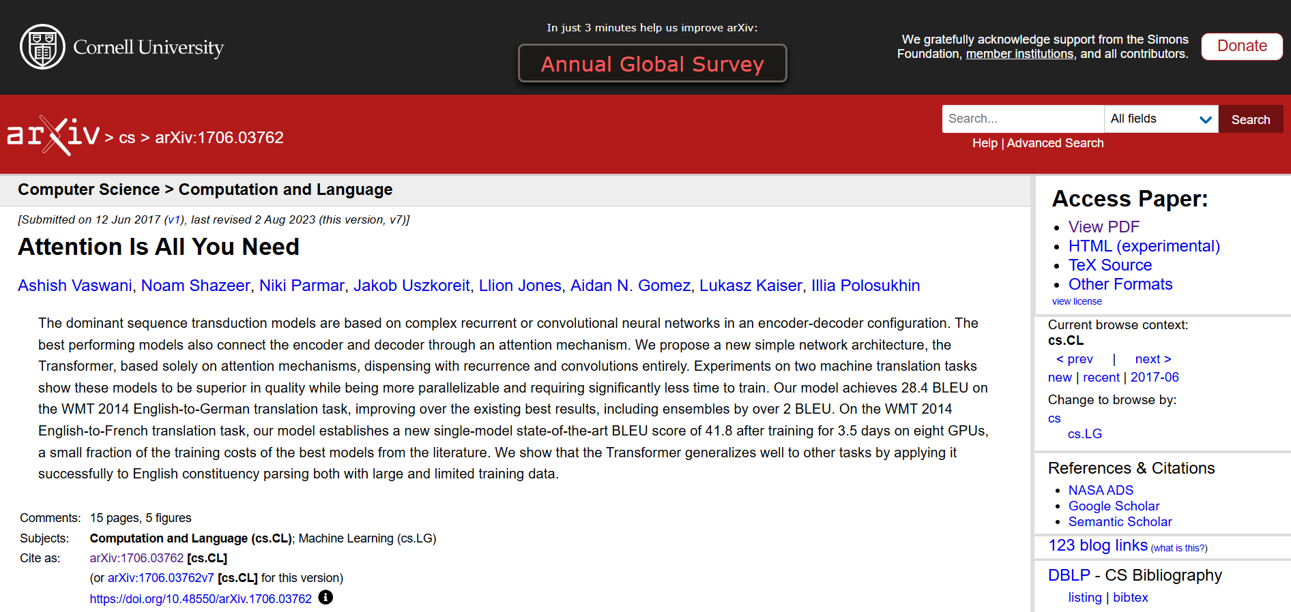
What is a Transformer?
Attention Is All You Need: https://arxiv.org/abs/1706.03762
© All rights reserved for Dr. Ryan Ahmed @Stemplicity Inc.

Slide 12
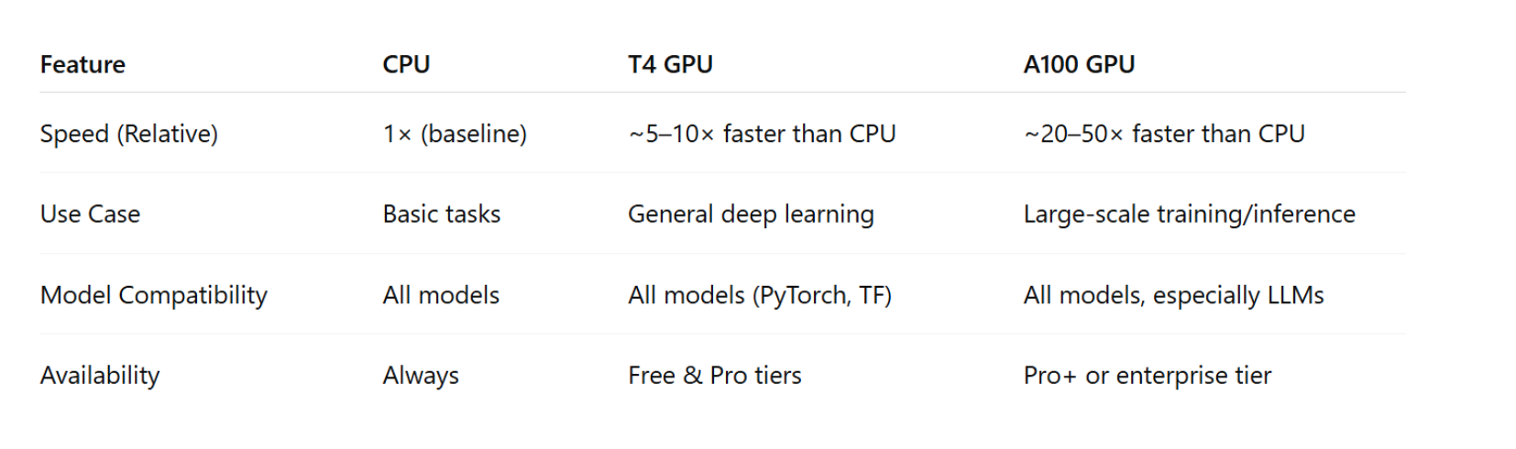
GPUs Vs. CPUs
© All rights reserved for Dr. Ryan Ahmed @Stemplicity Inc.
A100 GPUs: https://www.nvidia.com/en-us/data-center/a100/

Slide 13

Summary
Gained a solid understanding of Hugging Face’s role in democratizing AI through open-source models and tools.
Practiced using transformers, pypdf, and Gradio libraries for real-world AI applications, such as document-based Q&A systems.
Learned to run large models within limited computing resources using bitsandbytes for quantization in Google Colab.
Applied prompt design techniques and built interactive UIs to improve user experience and test multiple models easily.
Understood the concept of Tokenization in Large Language Models.
Learned the difference between pipeline() (task-based interface), AutoTokenizer (text to tokens), and AutoModelFor... (model loading for specific tasks).
© All rights reserved for Dr. Ryan Ahmed @Stemplicity Inc.

Slide 14
Thank you!

